Slide 1



AAAI-19: Thirty-Third AAAI Conference on Artificial Intelligence
A Theoretically Guaranteed Deep Optimization Framework for Robust Compressive Sensing MRI
Risheng Liu ^{1,2,*} Yuxi Zhang ^{1,2} Shichao Cheng ^{2,3} Xin Fan ^{1,2} Zhongxuan Luo ^{1,2,3,4}
^{1.} DUT-RU International School of Information Science & Engineering, Dalian University of Technology, Dalian, China
^{2.} Key Laboratory for Ubiquitous Network and Service Software of Liaoning Province, Dalian, China
^{3.} School of Mathematical Science, Dalian University of Technology, Dalian, China
^{4.} Institute of Artificial Intelligence, Guilin University of Electronic Technology, Dalian, China
Dalian University of Technology Feb. 1th, 2019

Slide 2
Motivation

Slide 3
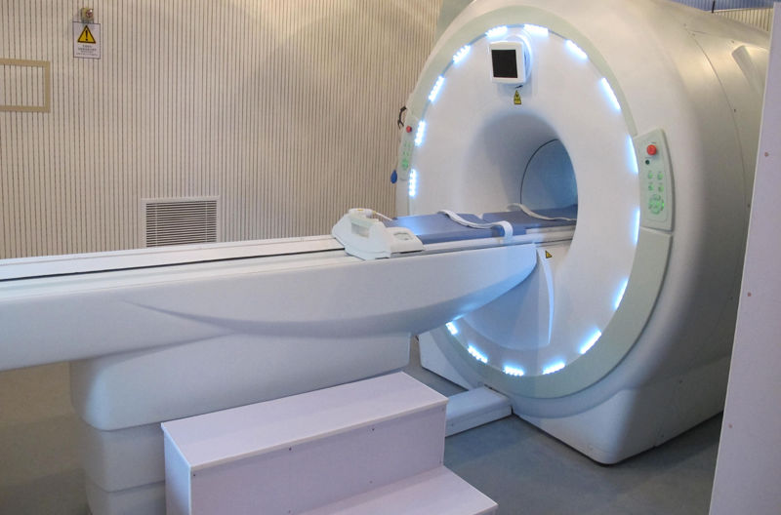
Motivation MRI
Magnetic Resonance Imaging (MRI)
None-invasive
Anatomical information
Slow acquisition
Artifacts introducing
Expensive calculation

Slide 4
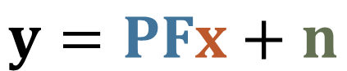
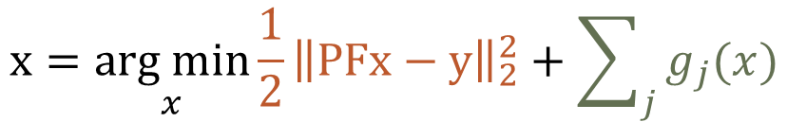
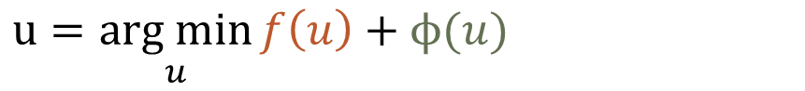

Motivation CS-MRI
Compressive Sensing MRI (CS-MRI)
data
acquisition
sparse K-space data
desired MR image
Signal processing based MRI reconstruction
Much lower sampling rate than Nyquist rate
Preserving image quality
$$y=PFx+n$$
under-sampling operation
$\text{acquisition} \text{noises}$
fast Fourier transform
reconstruction
$$x=\underset{x}{arg min}{{\frac{1}{2}\left\|PFx−y\right\|}_{2}^{2}+\sum_{j}{g_{j}(x})}$$
Optimization
$u=\underset{u}{arg min}{f\left(u\right)+ϕ(u)}$
Loss/Fidelity
Prior/Regularization

Slide 5
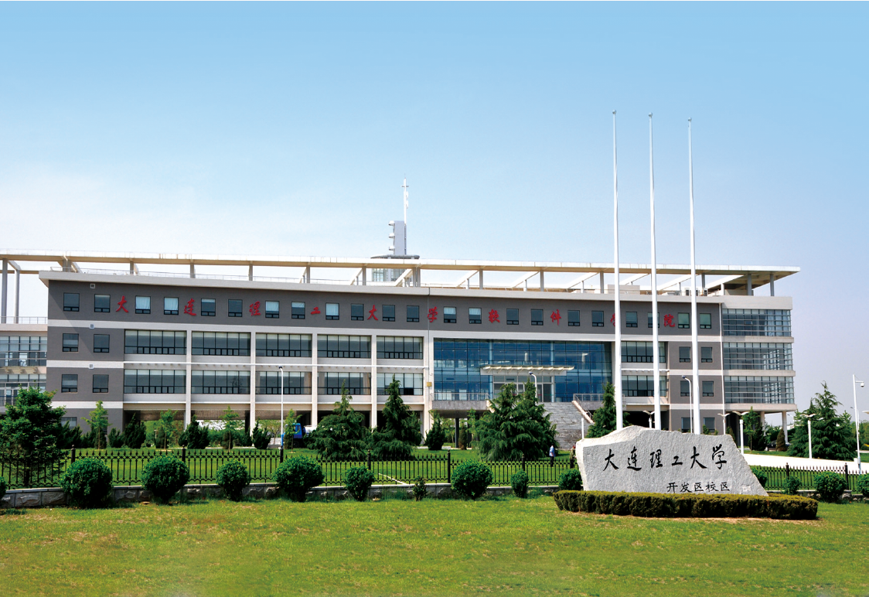

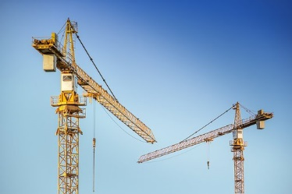
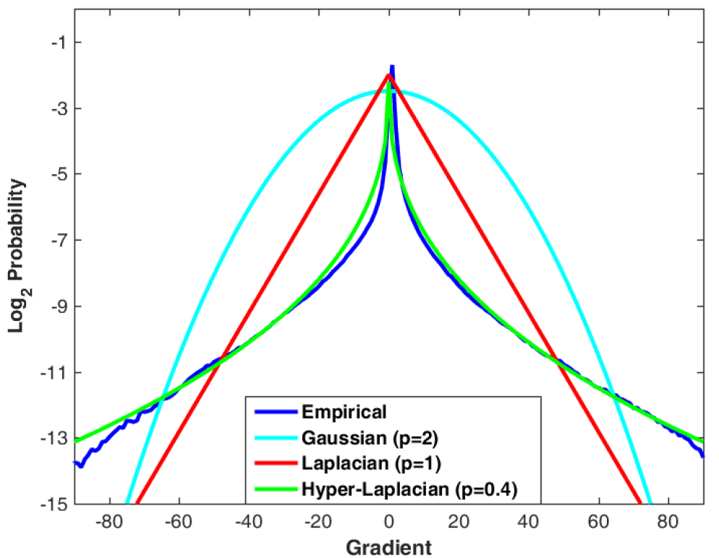
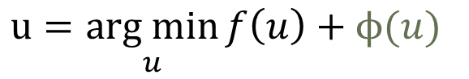
Motivation Image processing in multimedia
Model Optimization
Highly ill-posed
Require additional skills
High computational cost
Hand-crafted
priors
$u=\underset{u}{arg min}{f\left(u\right)+ϕ(u)}$
Hyper-Laplacian prior
Total variation prior
Non-local similarity prior
Dark channel prior

Slide 6
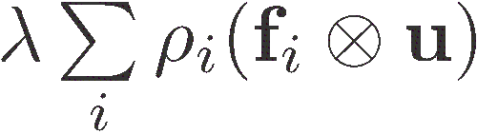
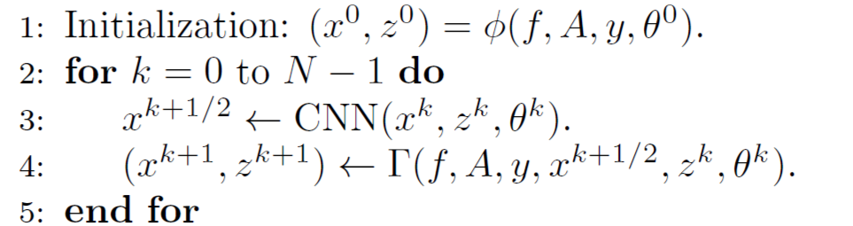
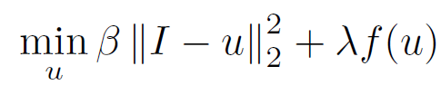
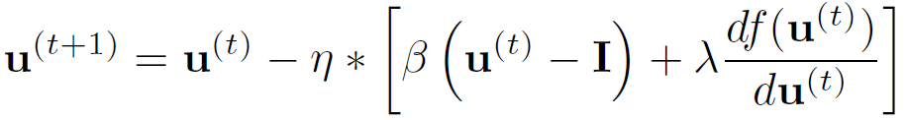
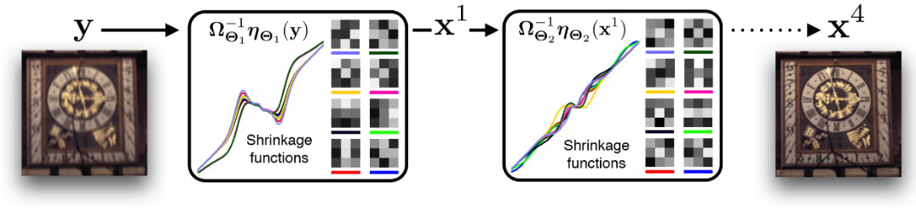
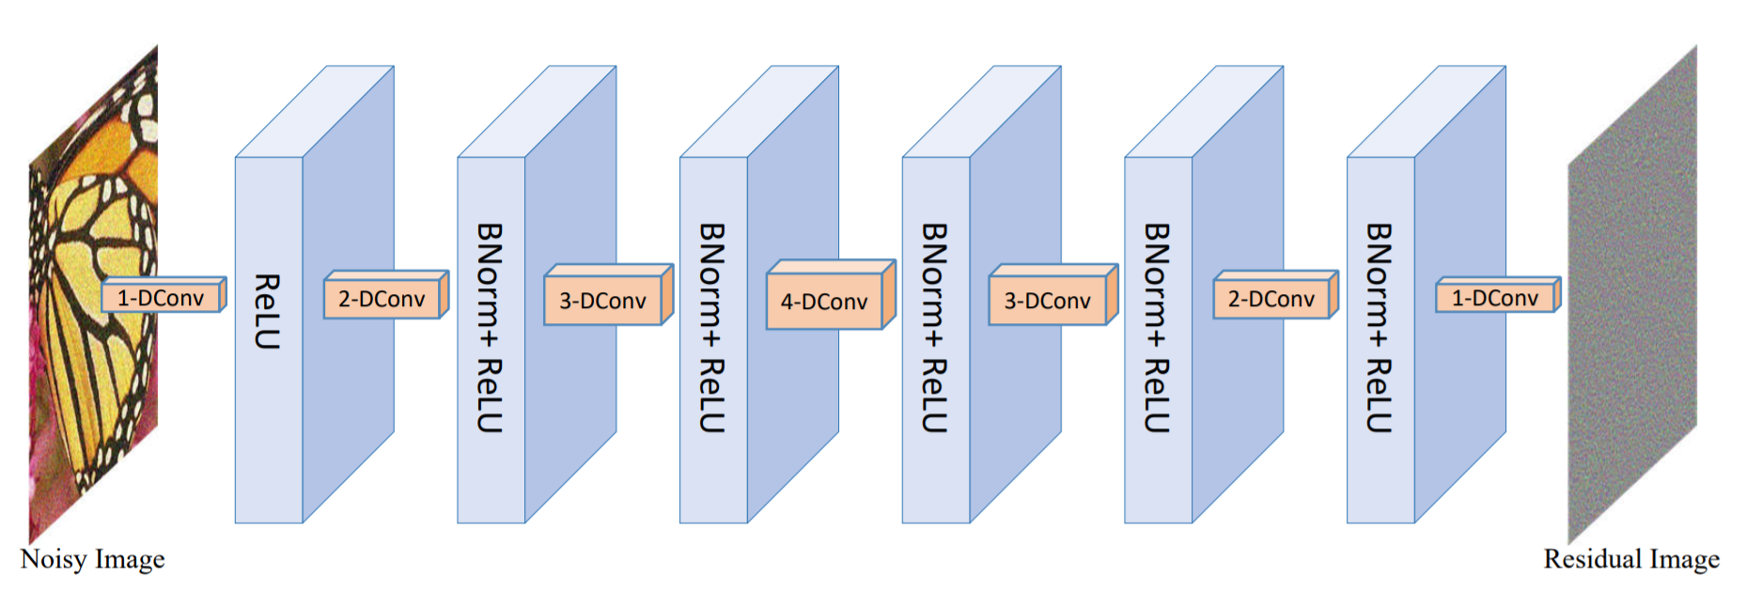
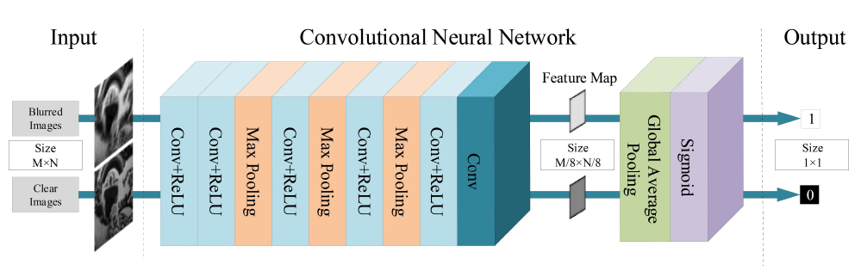
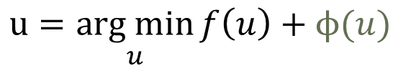
Motivation Image processing in multimedia
Model Optimization
Learnable
priors
No theoretical guarantee
Data dependent
Rely on architecture
$u=\underset{u}{arg min}{f\left(u\right)+ϕ(u)}$
MRF prior
Denoise CNN prior
Discriminative prior

Slide 7
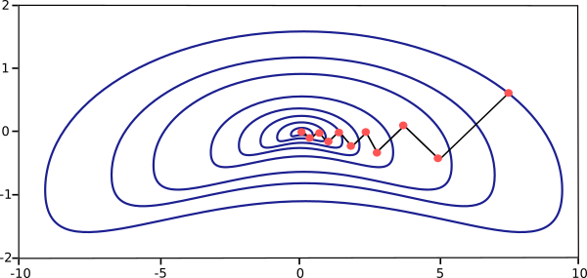
Motivation Image processing in multimedia
Model Optimization
Physical principles and priors
Theoretical derivation
White box
Optimization
High computational cost
Less flexibility and capability
Stage 1
Stage 2
......
Stage T

Slide 8
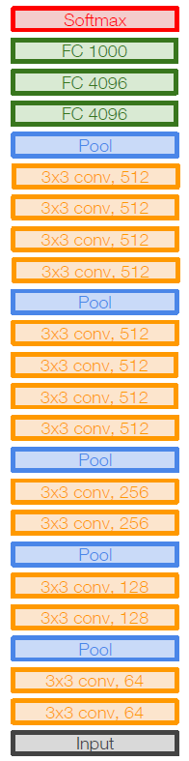
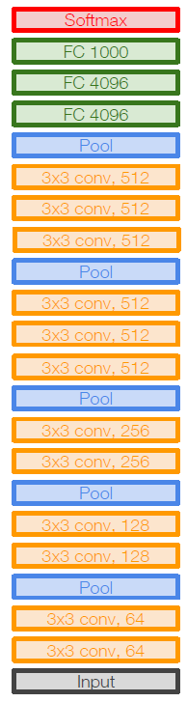
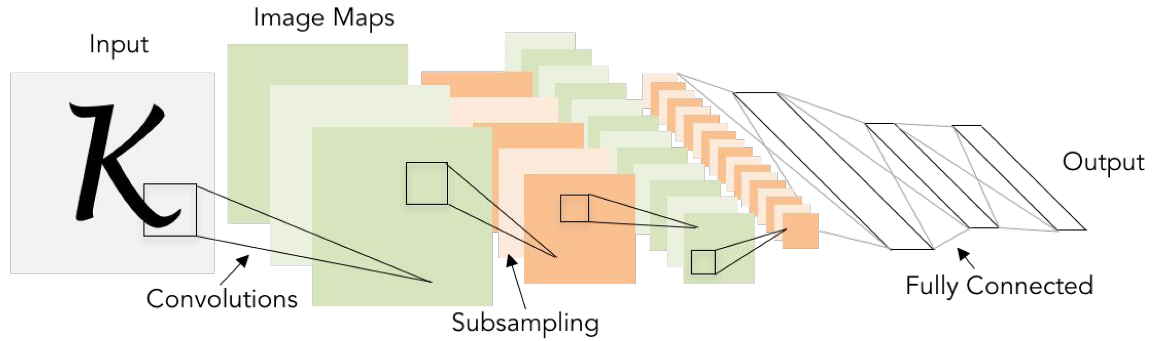
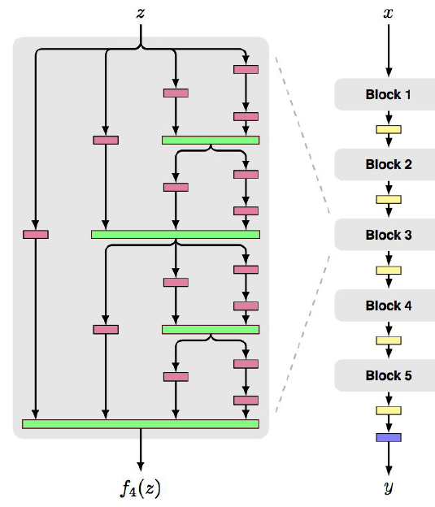
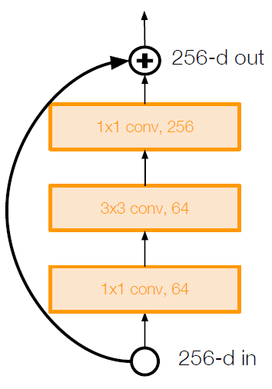
Motivation Image processing in multimedia
End-to-end
Fast forward process
Data driven
Neural networks
Severe data dependence
Weak interpretability
Instable inference
LeNet-5
AlexNet
ResNet
FractalNet
VGG16
VGG19

Slide 9
Motivation Image processing in multimedia
Model Optimization
Model based principles
Data driven information
Hybrid framework
No guarantee on convergence
Sacrificing model based information
?
Stage 1
Stage 2
......
Stage T

Slide 10
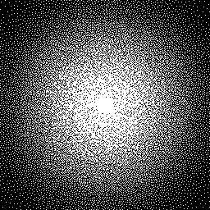
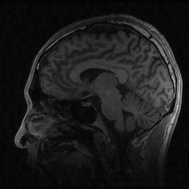
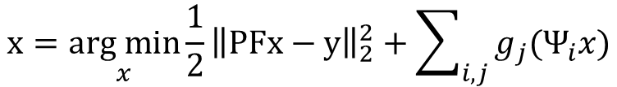
Motivation CS-MRI
Reconstruction of CS-MRI
Sparse K-space Data
Reconstruction Process
Reconstructed MRI
$$x=\underset{x}{arg min}{{\frac{1}{2}\left\|PFx−y\right\|}_{2}^{2}+\sum_{i,j}{g_{j}(Ψ_{i}x})}$$
sparse representation (TV et.al)
wavelet transform (PBDW et.al)
dictionary learning (FDLCP et.al)
non-local method (PANO et.al)
deep learning based (DAGAN et.al)

Slide 11
Motivation problems in existing methods
Model based methods
Model based prior
Satisfying restoration accuracy
High computational cost
Efficiency
Deep learning based methods
Fast feed-forward process
Data driven prior
Lower flexibility and robustness
Robustness
Hybrid process based methods
Efficiency improvement
No guarantee on convergence
Sacrificing model based information
Convergence
Accuracy

Slide 12
Our Paradigm for CS-MRI
A Theoretically Guaranteed Deep Optimization Framework
for Robust Compressive Sensing MRI

Slide 13
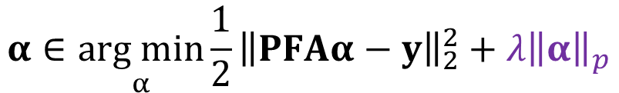
Our Paradigm contributions
CS-MRI optimization model
Sparsity regularization
$$α∈\underset{α}{arg min}{{\frac{1}{2}\left\|PFAα−y\right\|}_{2}^{2}+{λ\left\|α\right\|}_{p}}$$
$α:$sparse code of x$A$: wavelet basis ($x=Aα$)$λ:$ trade-off parameter
Framework composition
Fidelity Module——Reconstruction
Data-driven Module——Artifacts removal
Optimal Condition Module——Error control
Prior Module——Details restoration

Slide 14
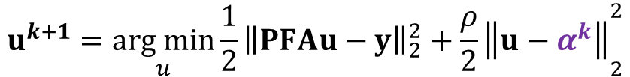
Our Paradigm Fidelity Module
Rough reconstruction
current restoration
$$u^{k+1}=\underset{u}{arg min}{{\frac{1}{2}\left\|PFAu−y\right\|}_{2}^{2}+{\frac{ρ}{2}\left\|u−α^{k}\right\|}_{2}^{2}}$$
Closed form solution
$$u^{k+1}=ℱ\left(α^{k};ρ\right)=A^{T}F^{T}{{(P^{T}P+ρI)}^{−1}(P^{T}y+ρFAα^{k})}$$
Effects
A balance between the current restoration and the fidelity term
A correction by the fidelity when the output is out of the desired descent direction
Artifacts introducing

Slide 15
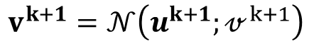
Our Paradigm Data-driven Module
Residual learning network
$$v^{k+1}=𝒩\left(u^{k+1};𝓋^{k+1}\right)$$
Effects
Realizing Artifacts removal
Utilizing Data dependent information utilizing
Providing Fast forward pass process
No guarantee on convergence

Slide 16
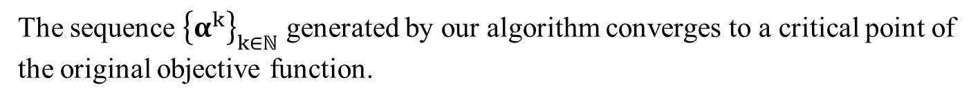
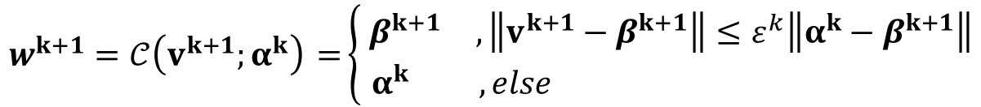
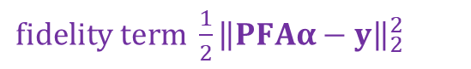
Our Paradigm Optimal Condition Module
Feedback mechanism based on momentum proximal gradient
$fidelity term {\frac{1}{2}\left\|PFAα−y\right\|}_{2}^{2}$
$$β^{k+1}∈{prox}_{η_{1}{λ\left\|∙\right\|}_{p}}\left(v^{k+1}−η_{1}\left(∇f\left(v^{k+1}\right)+ρ\left(v^{k+1}−α^{k}\right)\right)\right)$$
$$w^{k+1}=𝒞\left(v^{k+1};α^{k}\right) =\left\{ \begin{matrix}β^{k+1} & , \left\|v^{k+1}−β^{k+1}\right\|≤ε^{k}\left\|α^{k}−β^{k+1}\right\| \\ α^{k} & ,else \end{matrix}\right.$$
Theorem
The sequence ${\left\{α^{k}\right\}}_{k∈ℕ}$ generated by our algorithm converges to a critical point of the original objective function.
Effects
Have the similar convergence conclusion with the traditional first-order optimality methods, even with deep architecture

Slide 17
Our Paradigm Prior Module
Residual learning network
$$α^{k+1}=𝒫\left(w^{k+1};η_{2}\right)∈{prox}_{η_{2}{λ\left\|∙\right\|}_{p}}\left(w^{k+1}−η_{2}∇f\left(w^{k+1}\right)\right)$$
Effects
Enhancing the effect of sparse prior regularization
Correcting over-smooth problem
Revealing more details

Slide 18
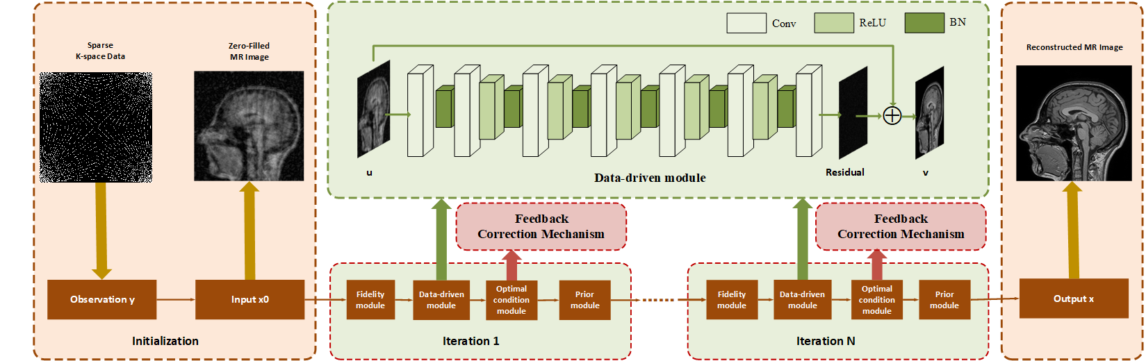
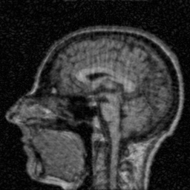



Our Paradigm Pipeline
Convergence guarantee
Input
Zero-filled image
Fidelity module
Rough reconstruction
Data-driven module
Artifacts removal
Prior module
Details restoration

Slide 19
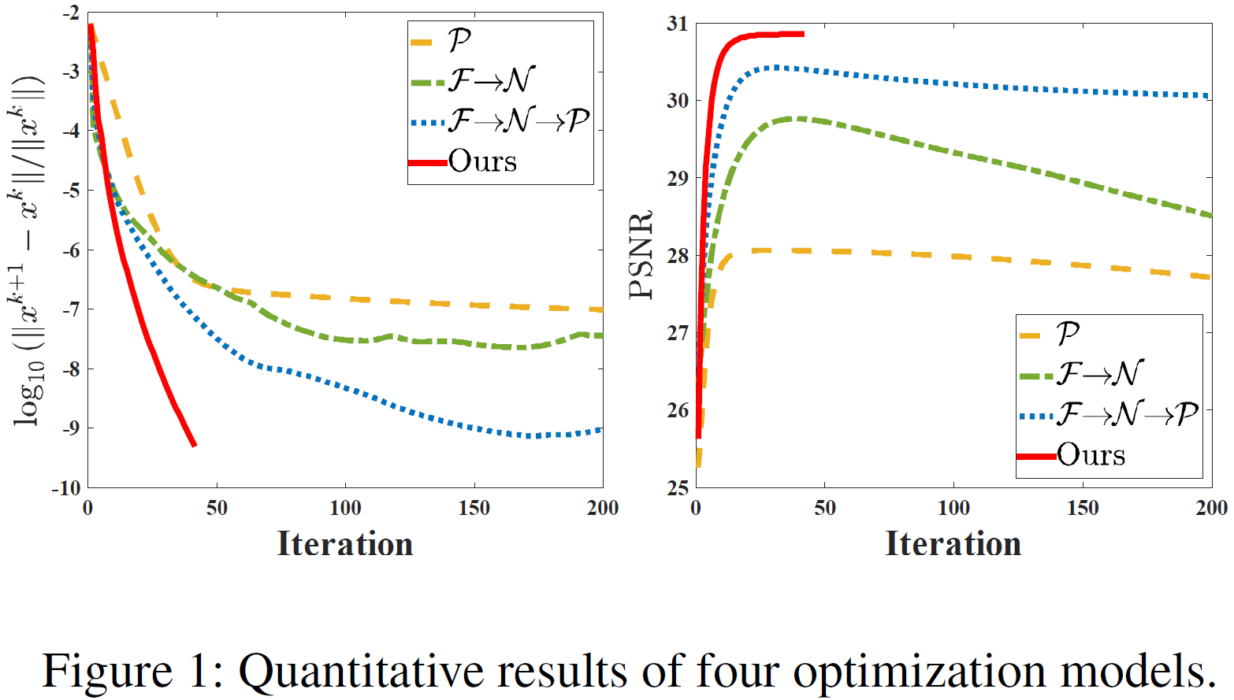










Our Paradigm Experiments
$$ℱ\left(α^{k};ρ\right)$$
$$ℱ\left(α^{k};ρ\right)$$
$$𝒩\left(u^{k+1};𝓋^{k+1}\right)$$
$$ℱ\left(α^{k};ρ\right)$$
$$𝒩\left(u^{k+1};𝓋^{k+1}\right)$$
$$𝒞\left(v^{k+1};α^{k}\right)$$
$𝒫\left(w^{k+1};η_{2}\right)$
$$𝒩\left(u^{k+1};𝓋^{k+1}\right)$$
$𝒫\left(w^{k+1};η_{2}\right)$
$𝒫\left(w^{k+1};η_{2}\right)$

Slide 20
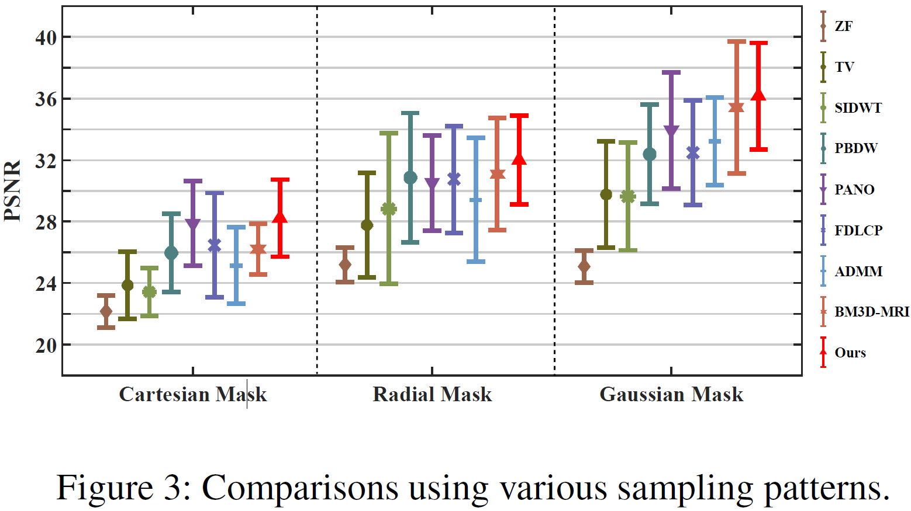
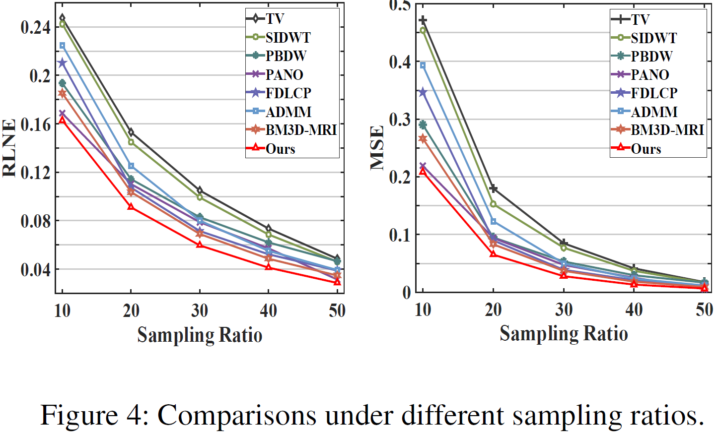
Our Paradigm Experiments
Ability to handle different sampling ratios and sampling patterns
Highest reconstruction accuracy
Lowest reconstruction error
Strongest robustness to variation of sampling patterns and ratios

Slide 21
Our Paradigm Experiments
Comparison of Execute Time (s)
Sampling Rate | Data | ZF | TV | SIDWT | PBDW | PANO | FDLCP | ADMM-Net | BM3D-MRI | Ours
10% | T1w | 0.0035 | 2.0098 | 14.8269 | 45.2639 | 27.9626 | 84.8494 | 1.2332 | 10.8777 | 0.3167
 | T2w | 0.003 | 2.3625 | 20.9462 | 53.0273 | 42.9235 | 84.1869 | 1.2349 | 9.5716 | 0.3631
50% | T1w | 0.0032 | 0.7631 | 5.5761 | 26.1274 | 11.1466 | 83.068 | 1.2499 | 11.5394 | 0.5633
 | T2w | 0.0036 | 0.7013 | 5.7678 | 24.8526 | 14.4659 | 81.8903 | 1.2445 | 10.6671 | 0.5545
Notice that ADMM-Net and ours are tested on GPU.
The proposed framework can ideally provide a efficient reconstruction process and comes to the fastest method among the competitors.

Slide 22
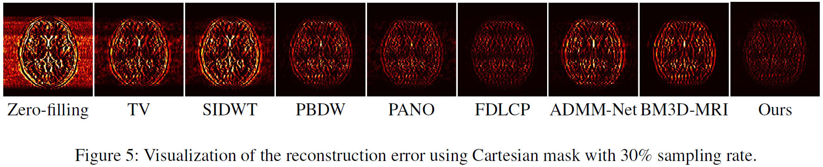
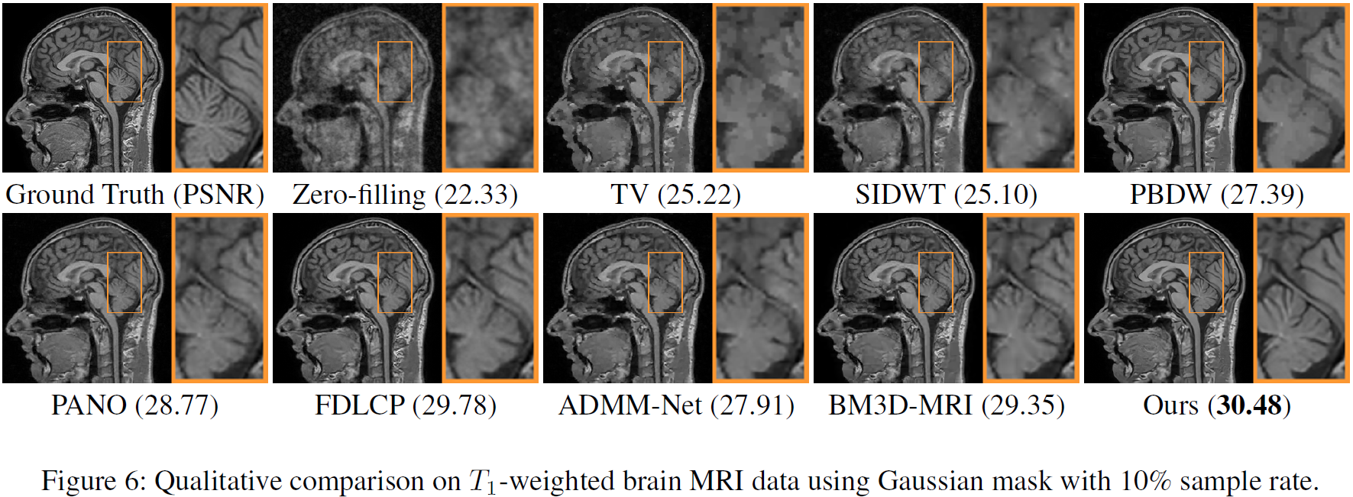
Our Paradigm Experiments
Visualization comparison

Slide 23
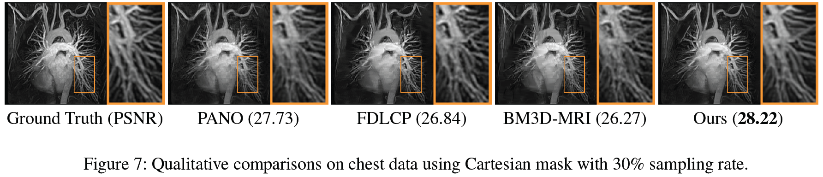
Our Paradigm Experiments
Robust to various kinds of testing data
Data | ZF | TV | SIDWT | PBDW | PANO | FDLCP | ADMM-Net | BM3D-MRI | Ours
Chest | 22.95 | 24.43 | 24.17 | 25.91 | 27.73 | 26.84 | 25.38 | 26.27 | 28.22
Cardiac | 23.40 | 29.17 | 27.49 | 31.34 | 33.14 | 33.84 | 31.42 | 31.44 | 35.69
Renal | 24.32 | 28.77 | 27.66 | 31.05 | 32.21 | 33.74 | 31.13 | 31.01 | 34.79

Slide 24
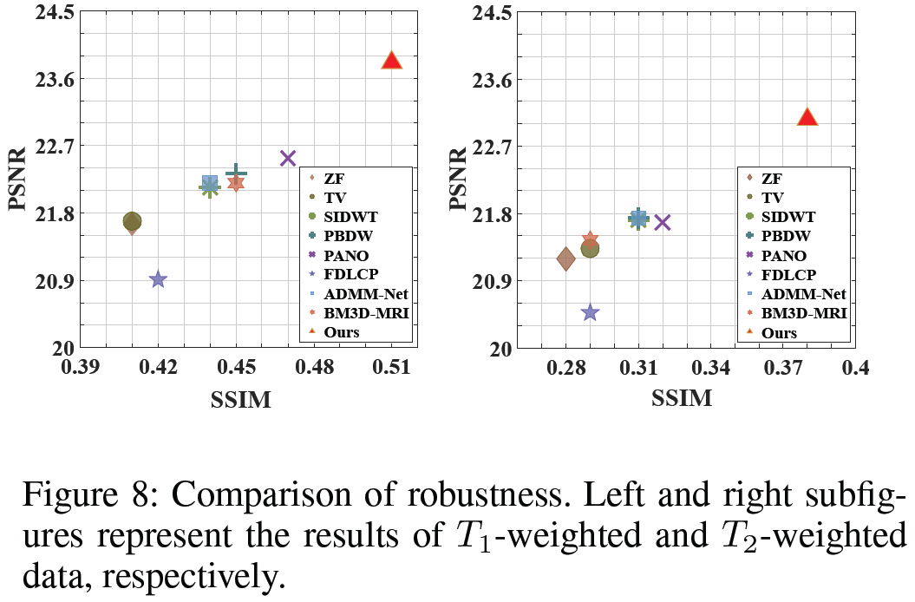
Our Paradigm Experiments
Robust to Rician noise pollution
our method has a better noise tolerance than the others,

Slide 25
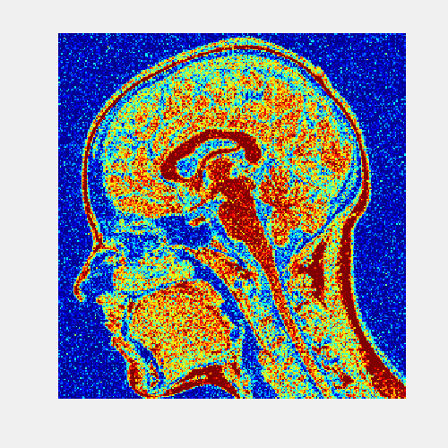
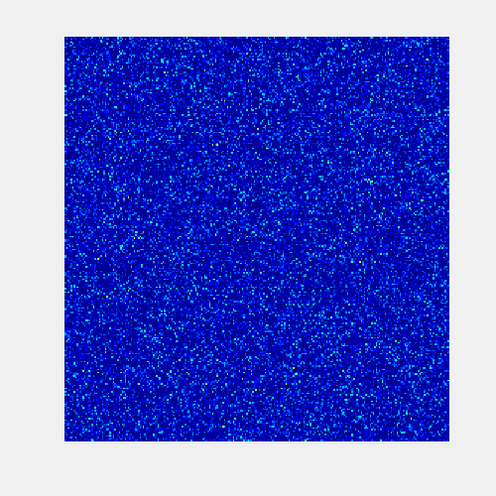
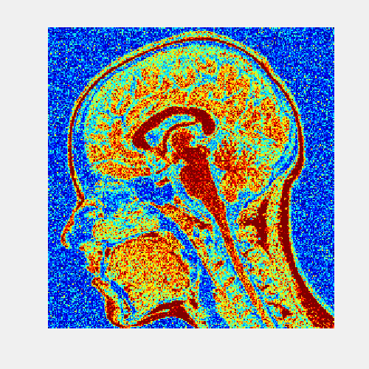
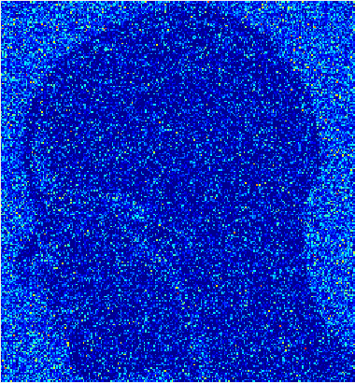
CS-MRI with Rician Noise Rician Noise
Rician Noise
MRI scanners acquire complex data where both real and imaginary parts are corrupted with zero-mean uncorrelated Gaussian noise with equal variance.
The calculation of the magnitude image transforms the original complex Gaussian noise into Rician noise.
Rician Noise for magnitude MR image
Guassian Noise
noisy image - clean image
Rician Noise
noisy image - clean image
Rician noise is not additive noise

Slide 26
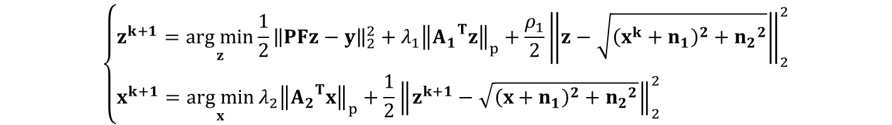
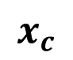
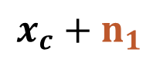
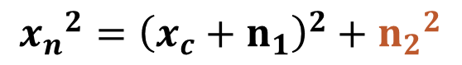
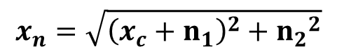
CS-MRI with Rician Noise Optimization
Alternating over two sub-problems
$$\left\{\begin{aligned}z^{k+1}=\underset{z}{arg min}{{\frac{1}{2}\left\|PFz−y\right\|}_{2}^{2}+{λ_{1}\left\|{A_{1}}^{T}z\right\|}_{p}+\frac{ρ_{1}}{2}{\left\|z−\sqrt{{\left(x^{k}+n_{1}\right)}^{2}+{n_{2}}^{2}}\right\|}_{2}^{2}} \\ x^{k+1}=\underset{x}{arg min}{{λ_{2}\left\|{A_{2}}^{T}x\right\|}_{p}+\frac{1}{2}{\left\|z^{k+1}−\sqrt{{\left(x+n_{1}\right)}^{2}+{n_{2}}^{2}}\right\|}_{2}^{2}} \end{aligned}\right.$$
Noisy image reconstruction
Clear image reconstruction
Learnable architecture for Rician noise removal
$$x_{n}=\sqrt{{\left(x_{c}+n_{1}\right)}^{2}+{n_{2}}^{2}}$$
Rician noise
Gaussian noise
Clean image
$${x_{n}}^{2}={\left(x_{c}+n_{1}\right)}^{2}+{n_{2}}^{2}$$
ResNet 1
$$x_{c}+n_{1}$$
ResNet 2
$$x_{c}$$

Slide 27
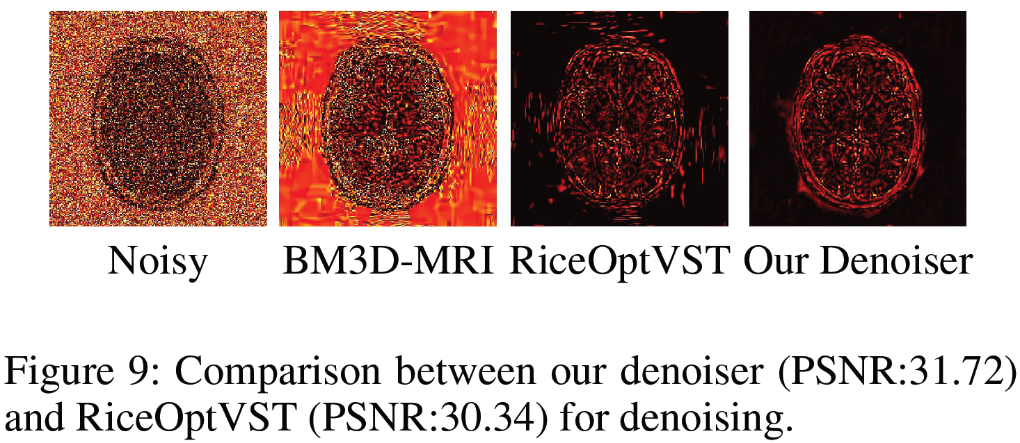
CS-MRI with Rician Noise Experiments
Comparison with classical Rician noiser remover
The choice of taking our learnable architecture as denoiser performs better than that of taking RiceOptVST.

Slide 28

CS-MRI with Rician Noise TwoNets_CS+Denoising
Comparison with traditional CS-MRI methods followed by a denoiser
Data | Denoiser | Zero-Filling | TV | SIDWT | PBDW | PANO | FDLCP | ADMM-Net | BM3D-MRI | Ours
T1w | RiceOptVST | 24.11 | 25.51 | 25.78 | 26.65 | 27.08 | 20.71 | 26.36 | 27.36 | 28.05
 | Ours | 24.62 | 25.71 | 25.94 | 26.83 | 27.30 | 25.42 | 26.49 | 27.64
T2w | RiceOptVST | 25.40 | 27.83 | 28.37 | 29.13 | 29.22 | 20.34 | 29.14 | 29.67 | 30.77
 | Ours | 26.36 | 28.20 | 28.68 | 29.46 | 29.64 | 27.21 | 29.45 | 30.34
Notes:
该图比较了“先重建后去噪”（A+B）与我们提出的迭代框架（A○B）的性能。
横坐标为B选RiceOptVST的情况，纵坐标为B选TwoNets的情况，黄色三角形”Ours“表示A○B的情况，
可以看出对于A+B的形式，B选取TwoNets时重建结果更好，而A○B形式的重建结果则比A+B好

Slide 29
Conclusions
Efficiency
Deep optimization algorithms for CS-MRI reconstruction
Accuracy
Both model based and data dependent prior knowledge are utilized
Convergence
Automatic checking and feedback mechanism for error-control
Robustness
Extended scheme for real-world CS-MRI with Rician noise.

Slide 30
Thanks
AAAI-19: Thirty-Third AAAI Conference on Artificial Intelligence
rsliu@dlut.edu.cn
yuxizhang@mail.dlut.edu.cn
shichao.cheng@outlook.com
xin.fan@dlut.edu.cn
zxluog@dlut.edu.cn

